Slide 1
Complex Pricing
Direct Price Discrimination
Management 405
Prof. Paola Giuliano · UCLA Anderson

Slide 2
Complex Pricing · Course
Announcement
Problem Set 4
  Due November 21st
Management 405 · Complex Pricing
2

Slide 3
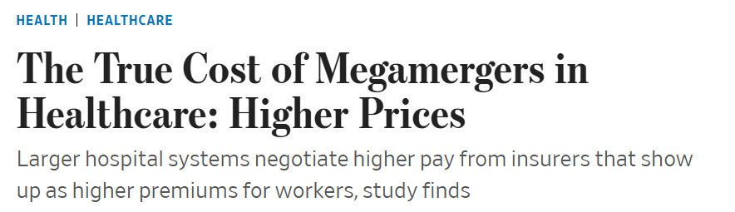
Complex Pricing · Discussion
In the News: Hospital Mergers
What does recent research show about prices for surgery, intensive care, and ER visits after hospital mergers?
Management 405 · Complex Pricing
3

Slide 4
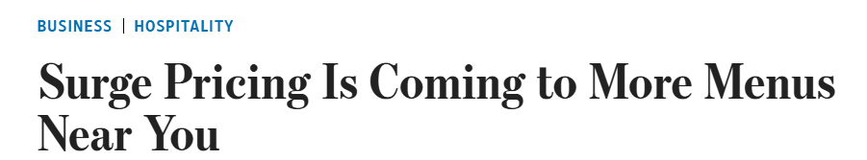
Complex Pricing · Discussion
In the News: Restaurant Dynamic Pricing
Describe this pricing strategy. Is it more profitable? Why do some chains reject it?
Do customers like dynamic pricing? Is there a generational difference?
Management 405 · Complex Pricing
4

Slide 5
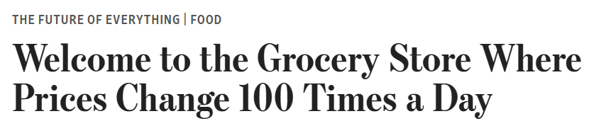
Complex Pricing · Discussion
In the News: Electronic Shelf Labels
What do you think about electronic shelf labels in grocery stores?
How are grocery stores using them at the moment?
Management 405 · Complex Pricing
5

Slide 6
Complex Pricing · Roadmap
Outline
1
Simple and complex pricing
The pricing dilemma and why complex pricing pays
2
Direct price discrimination
First-degree (perfect) and third-degree (segment) pricing
3
Indirect price discrimination
Versioning and coupons (second degree)
4
Advanced pricing strategies
Volume/flat-fee, two-part tariff, block pricing
5
Auctions
Competitive bidding and auction formats
Management 405 · Complex Pricing
6

Slide 7
Complex Pricing · Simple & Complex Pricing
Dilemma of Simple Pricing
Simple pricing: same price for all consumers
Limitations of simple pricing:
  If you charge a high price, you prevent low-willingness-to-pay customers from buying
  If you charge a low price, you are needlessly “generous” to high-willingness-to-pay customers
Management 405 · Complex Pricing
7

Slide 8

Complex Pricing · Simple & Complex Pricing
Simple Pricing per Movie (assume MC = 0)
P
Could Netflix do better than simple pricing?
P = 2 − Q/8
$2
MR
$1
Revenues
=$8
D
8
16
Movies
Management 405 · Complex Pricing
8
Notes:
When an individual can buy several units of an item, the seller can think about a volume pricing strategy. This is the case of continuous choice as opposed to binary choice (buy/don’t buy). Diminishing marginal personal value comes into play – the value of each subsequent unit falls.
We will talk about 3 kinds of volume pricing; we will see examples of each - they all amount to the same thing:
— Fixed fee + access price
— All or nothing pricing: bundle.
— Quantity discounts: sliding scale.
Examples of volume pricing:
— Rockreation: fixed monthly fee, unlimited access. Also, price differences with SLC. Is it price discrimination (probably, no – may reflect cost differentials, especially rent)
— Health Club: Annual fee
— Car Wash: Fixed fee - unlimited washes
— Netflix: Monthly fee – “unlimited” rentals
Analytics will help to clarify all this here. We still abstract from cost and set MC=0. The optimal price is where Q=10 because the slope of MR is twice the slope of D and we are setting MR=0. Under simple pricing, there is unexploited volume equal to the lower triangle ($100 of value) and the consumer retains a surplus of $100. The company ends up with revenues of $200. There is some opportunity to do some business here.

Slide 9
Complex Pricing · Simple & Complex Pricing
Simple Pricing: Geometric Representation
P
Consumer Surplus
P = 2 − Q/8
$2
▪ Simplifying assumption: MC = 0
Revenues
Unexploited Markets
▪ “Wasted profits”: consumer surplus + unexploited markets
▪ May do better using complex pricing
8
16
Q
Demand = Marginal Personal Value
Management 405 · Complex Pricing
9
Notes:
Ask in class if this is a price searcher or price taker
The dilemma of pricing is that if you charge a high price to capture a lot of value, you exclude many from wanting to buy the product, namely the hordes of those with valuations for the product that are lower than price. The alternative is to go with volume, but then you have to charge a low price and you give away a lot of consumer surplus, leave a lot of surplus on the table which you do not capture. There is a dilemma. Today we will see how to escape the dilemma through price discrimination.

Slide 10
Complex Pricing · Simple & Complex Pricing
Complex (Non-Uniform) Pricing
Requirements for complex pricing:
  Market power
  Perfect competition → price taker, cannot set a pricing strategy
  Market power → price searchers have pricing power
  Capacity to prevent resale and arbitrage
  Lets sellers charge different prices for different volumes/packages/customers
Complex pricing is usually more profitable than simple pricing
Management 405 · Complex Pricing
10
Notes:
Consumers are better off under resale: low-price consumers can resell their purchases at a profit; high-price consumers can buy product at a lower price than the firm would charge
Firms are not better off, since only selling at one price, the lower price!

Slide 11
Complex Pricing · Simple & Complex Pricing
Three Degrees of Price Discrimination
First degree: “dream world” — firm knows each consumer’s willingness to pay
Third degree: firm identifies groups with different price sensitivities before purchase (students, seniors, tourists)
Second degree: firm cannot identify types; uses purchase options to infer willingness to pay (versioning, quantity discounts, coupons)
Management 405 · Complex Pricing
11
Notes:
Consumers are better off under resale: low-price consumers can resell their purchases at a profit; high-price consumers can buy product at a lower price than the firm would charge
Firms are not better off, since only selling at one price, the lower price!

Slide 12
Complex Pricing · Roadmap
Outline of Module 6
1
Simple and complex pricing
The pricing dilemma and why complex pricing pays
2
Direct price discrimination
First-degree (perfect) and third-degree (segment) pricing
3
Indirect price discrimination
Versioning and coupons (second degree)
4
Advanced pricing strategies
Volume/flat-fee, two-part tariff, block pricing
5
Auctions
Competitive bidding and auction formats
Management 405 · Complex Pricing
12

Slide 13
Complex Pricing · Direct Price Discrimination
First-Degree Price Discrimination
Charge each customer a different price
Also known as perfect price discrimination
Conditions:
  Heterogeneous consumers: each with a different valuation
  Firm has market power and can prevent resale
  Firm knows each consumer’s willingness to pay
Management 405 · Complex Pricing
13

Slide 14
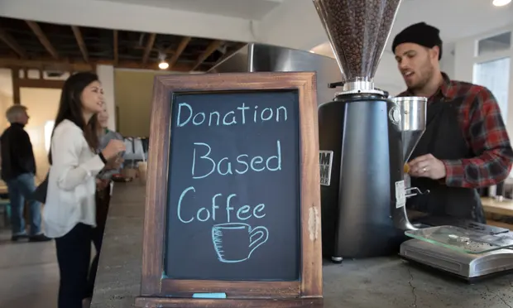
Complex Pricing · Direct Price Discrimination
First-Degree Price Discrimination
Assume MC = 0
Charge each customer a different price
The Holy Grail of complex pricing
Zero consumer surplus: everything is extracted!
Revenues and producer surplus (assume MC = 0)
Demand = MPV
Management 405 · Complex Pricing
14
Notes:
In an ideal world you would like to charge individual prices to mop up all the surplus – to capture all the area beneath the Demand curve in the form of corporate revenue. This type of customized pricing represents the ideal. Customized to what? To the buyers’ valuations! This is difficult to do in practice for a variety of reasons: e.g., arbitrage, legal restrictions.

Slide 15

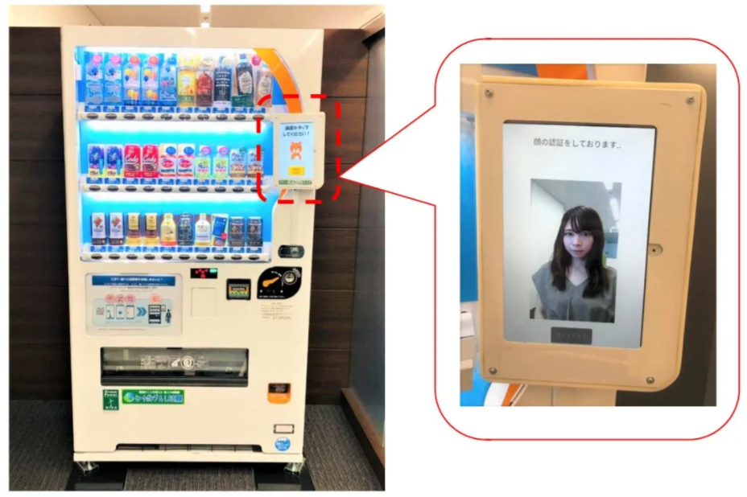
Complex Pricing · Direct Price Discrimination
Personalized Pricing in the Wild
Management 405 · Complex Pricing
15

Slide 16
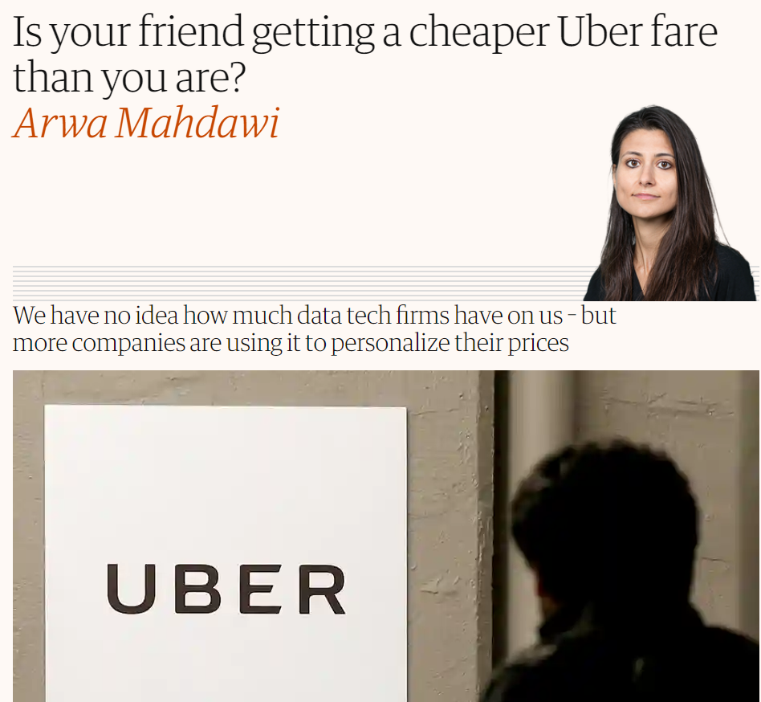
Complex Pricing · Direct Price Discrimination
Uber and First-Degree Price Discrimination
Do you think Uber does first-degree price discrimination?
Can this generate consumer backlash?
Let’s check…
Management 405 · Complex Pricing
16

Slide 17
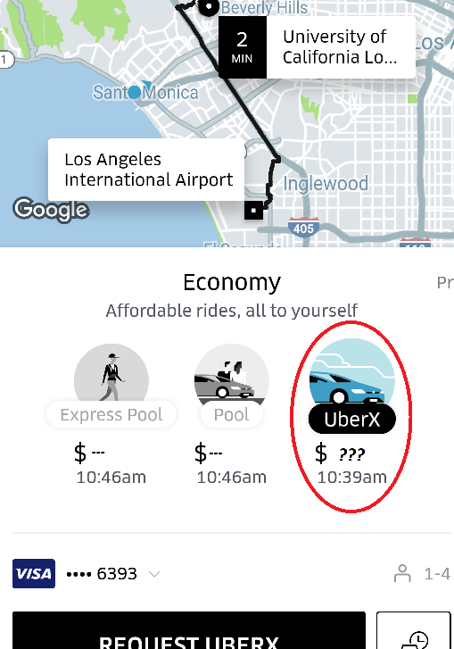
Complex Pricing · Direct Price Discrimination
Uber: Charging What You’re Willing to Pay?
I need 10 volunteers (5 for Uber, 5 for Lyft)
Open your Uber/Lyft app
Enter “LAX” in the destination address
Do NOT hit request
Just tell me the UberX/Lyft price
Group exercise break
Management 405 · Complex Pricing
17

Slide 18
Complex Pricing · Roadmap
Outline of Module 6
1
Simple and complex pricing
The pricing dilemma and why complex pricing pays
2
Direct price discrimination
First-degree (perfect) and third-degree (segment) pricing
3
Indirect price discrimination
Versioning and coupons (second degree)
4
Advanced pricing strategies
Volume/flat-fee, two-part tariff, block pricing
5
Auctions
Competitive bidding and auction formats
Management 405 · Complex Pricing
18

Slide 19

Complex Pricing · Segment Pricing
Third-Degree Price Discrimination — Segment (Group) Pricing
Divide customers into groups with different price sensitivities, and charge each group a different price
Conditions:
  Heterogeneous consumers
  Firm has market power and can prevent resale
  Firm can identify groups with different price sensitivities, but not each individual’s demand
Management 405 · Complex Pricing
19
Notes:
Say that computation: BMW + last PS

Slide 20
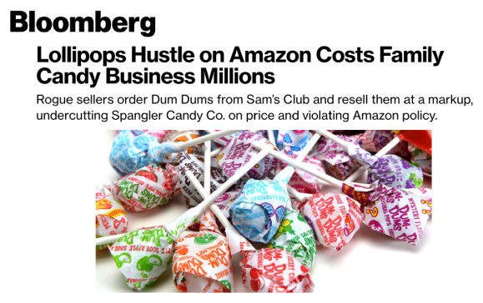
Complex Pricing · Segment Pricing
Key Assumption: Resale Is Prohibited
Management 405 · Complex Pricing
20
Notes:
One cannot ship products from other resellers
The sellers were ordering Dum Dums in bulk from Sam's Club and reselling them on Amazon. They were able to do this because it costs nothing to list a thousand items on Amazon, and they could find information on how to drop-ship on social media. Owens ordered a 500-pack of Dum Dums from one of the Amazon sellers and was surprised to find that they had been shipped directly from Sam's Club. A customer places an order, the company purchases the item from the supplier and the supplier sends it.

Slide 21
Complex Pricing · Segment Pricing
Third-Degree Price Discrimination
Price
Divide customers into groups with different price sensitivities
Charge each group different prices (lower prices to more elastic groups)
AKA segment pricing
Regular movie-goers
P₁
Seniors
P₂
Demand
Management 405 · Complex Pricing
21
Notes:
We reintroduce segment pricing, a concept already introduced in week 2 when we discussed Mercedes’s optimal pricing in the US and Germany, based on different elasticities.
At the car wash, senior citizens get a discount. This is price discrimination based on age. Why do firms select different prices for different segments? We talked about incentives to discriminate when different market segments exhibit different demand elasticities. You want to equate marginal revenue across segments, assuming marginal cost is equal across segments. The implication of this is that you want to charge a lower price for the more elastic segment.
So why are senior citizens more price sensitive?
Going to the car wash is a time consuming activity. It can take 40 minutes, sometimes more for an upscale treatment. Senior citizens can afford to drive around longer for a better deal. Opportunity cost of time. They have lower income, so they are more price sensitive The opportunity cost of time for a senior person is much lower than say for a professional. A professional is concerned about the value of time. Senior citizens don’t care so much about the time component of the cost of the car wash, so they are more sensitive to price.

Slide 22

Complex Pricing · Segment Pricing
Segment Pricing: Student Discounts
Management 405 · Complex Pricing
22
Notes:
Why would you charge lower price to students? lower incomes and more free time. As a result, they are more price-elastic and it is optimal to offer them discounts.
Trick: you need to “verify” that they are indeed students.

Slide 23
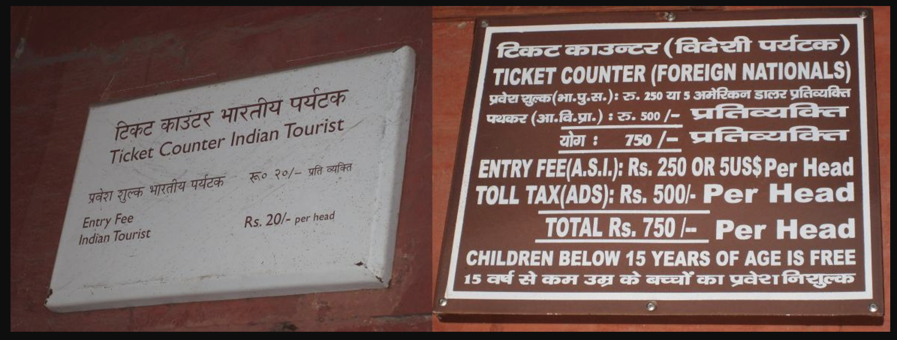
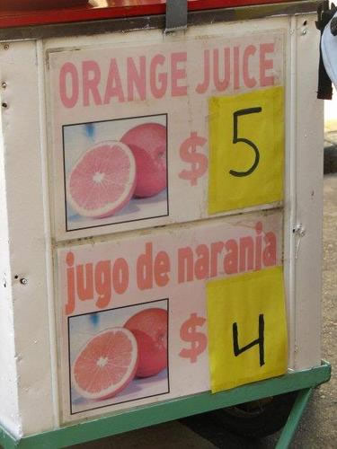
Complex Pricing · Segment Pricing
Segment Pricing: Discounts for Locals
Management 405 · Complex Pricing
23
Notes:
Disneyland and Taj Mahal: lower prices for Socal/Indian residents compared to tourists. Why? Tourists have lower elasticity of demand than locals that have more easily available alternatives (and in the Indian case, lower income). Generalized phenomenon in tourism – in India airlines used to charge higher fares to tourists.
Another Example: US drugs cheaper in Canada than in USA. There is more discretion as to price in the US because there is less collective bargaining between public entities and pharmaceutical companies for lower prices. This creates incentives for transshipping of drugs – parallel imports to take advantage of arbitrage opportunities.

Slide 24
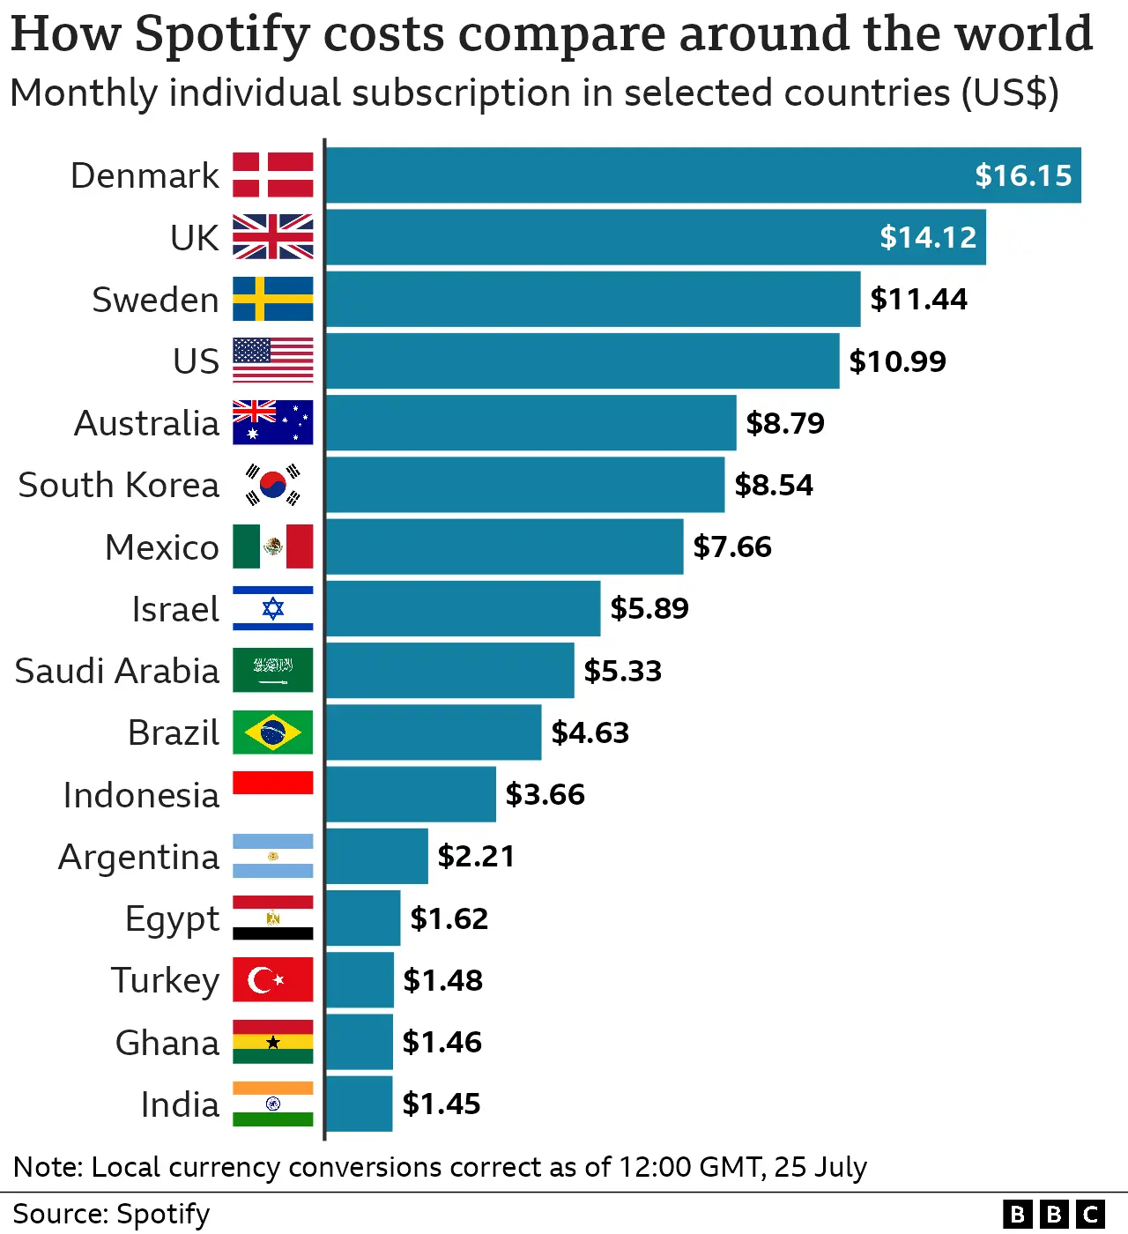
Complex Pricing · Segment Pricing
Segment Pricing: Discounts for Locals
Management 405 · Complex Pricing
24

Slide 25
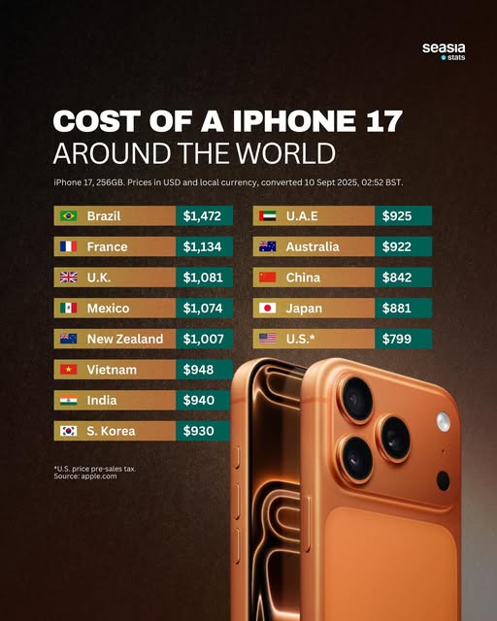
Complex Pricing · Segment Pricing
Segment Pricing: Discounts for Locals
Management 405 · Complex Pricing
25

Slide 26
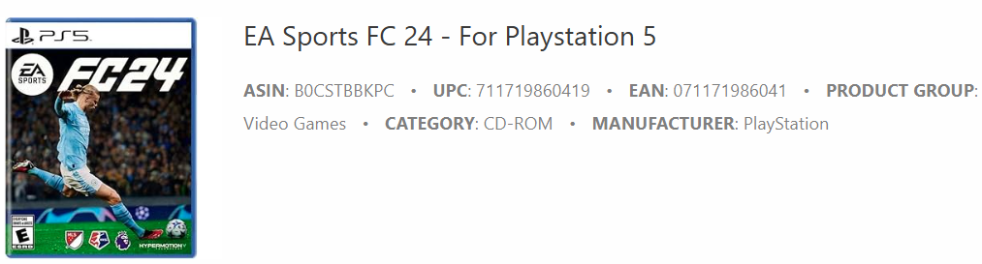
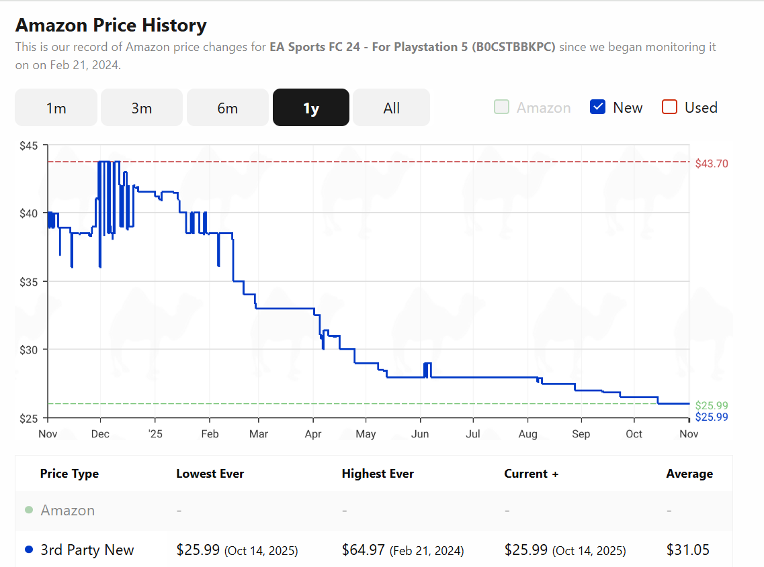
Complex Pricing · Segment Pricing
Segment Pricing: Timing
Management 405 · Complex Pricing
26
Notes:
One can go directly to the website and look for favourite goods. I use coffee moka bialetti:
https://camelcamelcamel.com/

Slide 27
Complex Pricing · Segment Pricing
Ways to Segment Consumers
By customer characteristics
  Age, gender — even species (doctors and veterinarians sometimes use the same medicines)
By past purchase behavior
  Discounts for new customers (gyms); discounts for current customers (software upgrades)
By location
  Pharmaceuticals in the U.S. vs. emerging economies
Intertemporal
  Early adopters vs. mass market; search-history pricing; Black Friday
Management 405 · Complex Pricing
27
Notes:
For next slide: the price of Lodine for humans is three times the price for animals

Slide 28
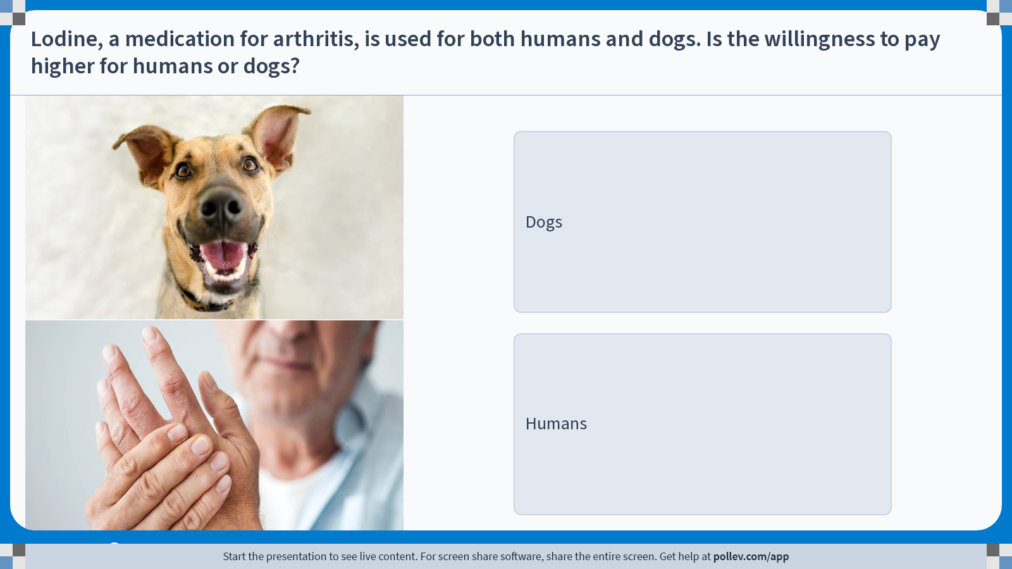
Notes:
Poll Title: Do not modify the notes in this section to avoid tampering with the Poll Everywhere activity.
More info at polleverywhere.com/support
Lodine, a medication for arthritis, is used for both humans and dogs. Is the willingness to pay higher for humans or dogs?
https://www.polleverywhere.com/multiple_choice_polls/AEWU6PkzQvpAnRnEJzTPV?display_state=instructions&activity_state=opened&state=opened&flow=Engagement&onscreen=persist

Slide 29
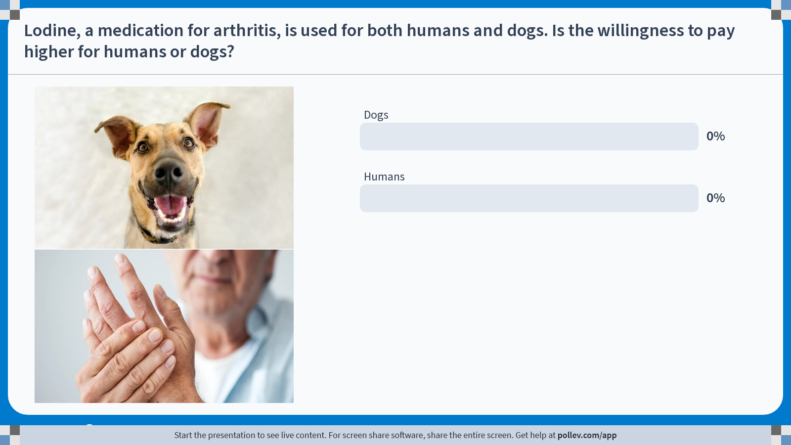
Notes:
Poll Title: Do not modify the notes in this section to avoid tampering with the Poll Everywhere activity.
More info at polleverywhere.com/support
Lodine, a medication for arthritis, is used for both humans and dogs. Is the willingness to pay higher for humans or dogs?
https://www.polleverywhere.com/multiple_choice_polls/AEWU6PkzQvpAnRnEJzTPV?display_state=chart&activity_state=opened&state=opened&flow=Engagement&onscreen=persist

Slide 30
Notes:
Poll Title: Do not modify the notes in this section to avoid tampering with the Poll Everywhere activity.
More info at polleverywhere.com/support
Lodine, a medication for arthritis, is used for both humans and dogs. Is the willingness to pay higher for humans or dogs?
https://www.polleverywhere.com/multiple_choice_polls/AEWU6PkzQvpAnRnEJzTPV?display_state=chart&activity_state=closed&state=closed&flow=Engagement&onscreen=persist

Slide 31
Complex Pricing · Segment Pricing
Price Segmentation and Elasticity
• Assume marginal cost is equal across the two market segments
• Profit maximization:
MR_{a} = MR_{b} (= MC)
• If MR_{a} ≠ MR_{b} , uniform pricing (P_{a} = P_{b}) won’t be optimal
RULE: charge higher prices in less elastic market
Management 405 · Complex Pricing
31

Slide 32

Complex Pricing · Segment Pricing
BMW and Segmentation
• Q : number of cars (in 1,000)
• (Inverse) demand in the US:
P = 160 − 4Q
• (Inverse) demand in Germany:
P = 140 − 5Q
• MC = 40 in both markets [in $1,000]
• What is the profit-maximizing price in the US and in Germany?
Group Exercise
Management 405 · Complex Pricing
32

Slide 33
Complex Pricing · Segment Pricing
Profit-Maximization in the U.S. Market
Compute MR:
P_{US} = 160 − 4Q_{US}
TR_{US} = P_{US}·Q_{US} = 160·Q_{US} − 4Q_{US}²
MR_{US} = dTR_{US}/dQ_{US} = 160 − 8Q_{US}
Set MR_{US} = MC (recall: MC = 40)
160 − 8Q_{US} = 40
Q_{US}* = 15
P_{US}* = 160 − 4·Q_{US}* ⇒ P_{US}* = 100
Management 405 · Complex Pricing
33

Slide 34
Complex Pricing · Segment Pricing
Profit-Maximization in Germany
Compute MR:
P_{G} = 140 − 5Q_{G}
TR_{G} = P_{G}·Q_{G} = 140·Q_{G} − 5Q_{G}²
MR_{G} = 140 − 10·Q_{G}
Set MR_{G} = MC (recall: MC = 40)
140 − 10Q_{G} = 40
Q_{G}* = 10
P_{G}* = 140 − 5·Q_{G}* ⇒ P_{G}* = 90
Management 405 · Complex Pricing
34

Slide 35
Complex Pricing · Segment Pricing
BMW and Segmentation
• MC = 40
• US Market
P_{US} = 160 − 4Q_{US}
Q_{US}* = 15 , P_{US}* = 100
• German Market
P_{G} = 140 − 5Q_{G}
Q_{G}* = 10 , P_{G}* = 90
• What is the demand elasticity at the profit-maximizing price, and the Lerner Index, in the two countries?
Group Exercise
Management 405 · Complex Pricing
35

Slide 36
Complex Pricing · Segment Pricing
Demand Elasticity and Mark-up: USA
Elasticity:
P_{US} = 160 − 4Q_{US} ⇒ Q_{US} = 40 − 0.25P_{US}
dQ_{US}/dP_{US} = −0.25 (slope of the demand curve)
E_{US} = (dQ_{US}/dP_{US})·(P_{US}/Q_{US}) = −0.25·(100/15) = −1.67
Lerner Index (mark-up):
(P − MC)/P = (100 − 40)/100 = 0.6
Recall (Module 5): (P − MC)/P = 1 / |E_{D}|
Management 405 · Complex Pricing
36

Slide 37
Complex Pricing · Segment Pricing
Demand Elasticity and Mark-up: Germany
Elasticity:
P_{G} = 140 − 5Q_{G} ⇒ Q_{G} = 28 − 0.2P_{G}
dQ_{G}/dP_{G} = −0.2 (slope of the demand curve)
E_{G} = (dQ_{G}/dP_{G})·(P_{G}/Q_{G}) = −0.2·(90/10) = −1.80
Lerner Index (mark-up):
(P − MC)/P = (90 − 40)/90 = 0.56
Lerner Index: (P − MC)/P = 1 / |E_{D}|
Management 405 · Complex Pricing
37

Slide 38
Complex Pricing · Segment Pricing
Segment Pricing: Take-Away
Optimization when selling in multiple markets:
  Set MR = MC in each market separately
Elasticity:
  Charge a higher price in the less elastic market (BMW example: higher price in the US)
Problem Set 4 · #4
Management 405 · Complex Pricing
38

Slide 39
Complex Pricing · Segment Pricing
Challenges with Segment Pricing for BMW
Suppose BMW sets very different prices in different countries — any problems?
Arbitrage: re-importation to the U.S.
  Hard here (miles vs. km; taxation), but easier elsewhere (e.g., textbooks from India)
Consumer backlash
Management 405 · Complex Pricing
39

Slide 40
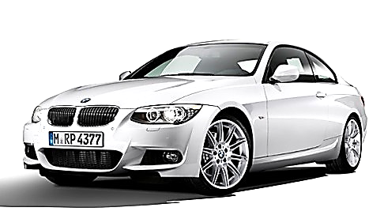
Complex Pricing · Segment Pricing
BMW Price Segmentation: A Graphical Answer
Segment Pricing Profits (B + C) > Uniform Pricing Profits (A)
Segment Pricing
Uniform Pricing
P
P
US Market
German Market
Joint Market
(Germany + US)
B
C
A
MC
MC
D_{T}
D_{US}
D_{G}
MC
MR_{US}
Q
MR_{G}
Q
MR_{T}
Q
Management 405 · Complex Pricing
40

Slide 41
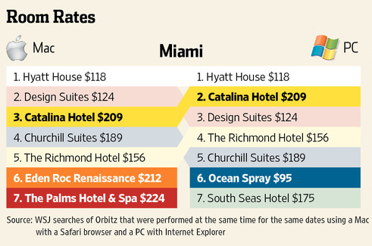
Complex Pricing · Segment Pricing
Impediments to Segment Pricing: Orbitz
Management 405 · Complex Pricing
41

Slide 42
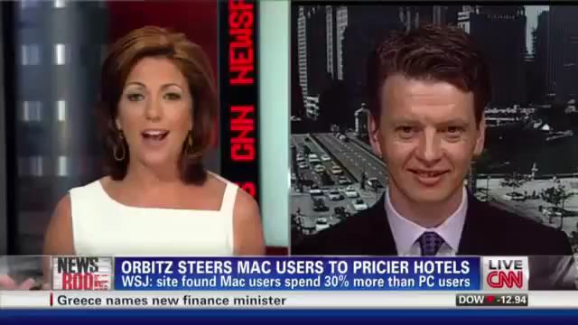
Complex Pricing · Segment Pricing
Impediments to Segment Pricing: Consumer Anger
Management 405 · Complex Pricing
42

Slide 43
Complex Pricing · Segment Pricing
Challenges with Segment Pricing
Segments must be kept separate
  Concerns regarding re-importation and arbitrage
Potential for backlash (consumer anger) — e.g., Target app
Legal impediment (Robinson-Patman Act, 1936)
Methods to circumvent these problems:
  Versioning (2nd-degree price discrimination)
Management 405 · Complex Pricing
43
Notes:
Impediments to segment pricing.
There are legal impediments: at the federal level in the US, the Robinson Patman Act of 1936 bars price discrimination that results in anticompetitive outcomes. There are also state statutes on this, so instance in California laundry services are barred from charging different prices to men and women. What defense would you use to justify such price differentials? Cost differentials.
Another problem is parallel sales from low price segments to high price segments. You need to keep your segments separate. In many instances people would not bother, but you can think of cases where it would make sense to arbitrage across segments – pharmaceuticals for instance. AIDS drugs in Africa example.
The main impediment is revelation of valuations: how does the firm find out what the valuations of the different segments are? The problem is that price discrimination per se is not incentive compatible: low elasticity customers have an incentive to misrepresent their demand elasticity so that it is perceived as high and they can get a lower price. For seniors at the carwash, it is hard to conceal their age. But in general it is hard to figure out who is price sensitive.

